Slide 1
Containers
Instructor: Engr. Muhammad Ahmad Nawaz

Slide 2
Contents
Containers
Containers tools
Docker
Features of Docker
Docker Architecture
Docker Management

Slide 3
Containers
Containers are packages of software that contain all of the necessary elements to run in any environment.
Containers provide a standard method of packaging an application's code, runtime, system tools, system libraries, and configurations into one instance.
Containers share one kernel (operating system), which is installed on the hardware.

Slide 4
Containers Tools
Docker
Kubernetes
And many more

Slide 5
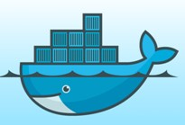
What is Docker?
Docker is a software platform that allows you to build, test, and deploy applications quickly, packaging software into standardized units called containers.

Slide 6
Features of Docker
Docker has the ability to reduce the size of development by providing a smaller footprint of the operating system via containers.
With containers, it becomes easier for teams across different units, such as development, QA and Operations to work seamlessly across applications.
You can deploy Docker containers anywhere, on any physical and virtual machines and even on the cloud.
Since Docker containers are pretty lightweight, they are very easily scalable.

Slide 7
Features of Docker (Cont.)
Easy and Faster Configuration: Deploy the code in less time and efforts.
Increase productivity: It has increase productivity.
Application Isolation: It is used to run applications in isolation environment. Each container is independent to another and allows us to execute any kind of application.

Slide 8
Install Docker on Windows
Docker install on any operating system i.e. Windows, Linux, or Mac.
https://www.docker.com/products/docker-desktop

Slide 9
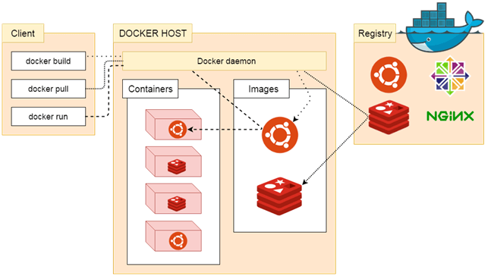
Docker Architecture

Slide 10
Docker Architecture (Cont.)
Docker follows Client-Server architecture.
There are three main components that are:
  Docker Client
  Docker Host
  Docker Registry.

Slide 11
Docker Architecture (Cont.)
Docker Client
  Docker client uses commands and REST APIs to communicate with the Docker Daemon (Server).
  When a client runs any docker command on the docker client terminal, the client terminal sends these docker commands to the Docker daemon. Docker daemon receives these commands from the docker client in the form of command and REST API's request.
  Some docker Commands
    docker build
    docker pull
    docker run

Slide 12
Docker Architecture (Cont.)
Docker Registry.
It is responsible to manages and stores the Docker images.
Provide repositories facilities on Docker hub (https://hub.docker.com/ ) .
There are two types of registries
  Pubic Registry
  Private Registry - It is used to share images within the enterprise.

Slide 13
Docker Architecture (Cont.)
Docker Host
This component are use to provide an environment to execute and run applications. It contains the docker daemon, images, containers, networks, and storage.

Slide 14
What is Docker Daemon?
The Docker daemon is a service that runs on your host operating system.
Also know as Server
It is responsible for running containers to manage Docker services and communicates with other daemons.
It offers various Docker objects such as images, containers, networking, and storage.

Slide 15
Docker Host Objects
Docker Images
  A Docker Image is a read-only file with a bunch of instructions. When these instructions are executed, it creates a Docker container.
  It use to describe about the container registry are public or private.
  A Docker image is described in text file called a Dockerfile, which has a simple, well-defined syntax.
Docker Dockerfile
  It is a text document that contains commands that are used to assemble an image. We can use any command that call on the command line. Docker builds images automatically by reading the instructions from the Dockerfile.
docker build -t ImageName:TagName dir
docker build -t comsatsimage

Slide 16
Docker Host Objects (Cont.)
Docker Containers
  Containers are the structural units of Docker.
  It is used to hold the entire package that is needed to run the application.
  The advantage of containers is that it requires very less resources.
  Simply, the image is a template, and the container is a copy of that template.

Slide 17
Docker Host Objects (Cont.)
Docker Networking
  Using Docker Networking, an isolated package can be communicated.
Docker Storage
  Docker Storage is used to store data on the container.

Slide 18
Docker Management
Managing the states of the Docker containers is called Docker Container Lifecycle Management.
For managing the Docker Lifecycle we have some common commands.

Slide 19
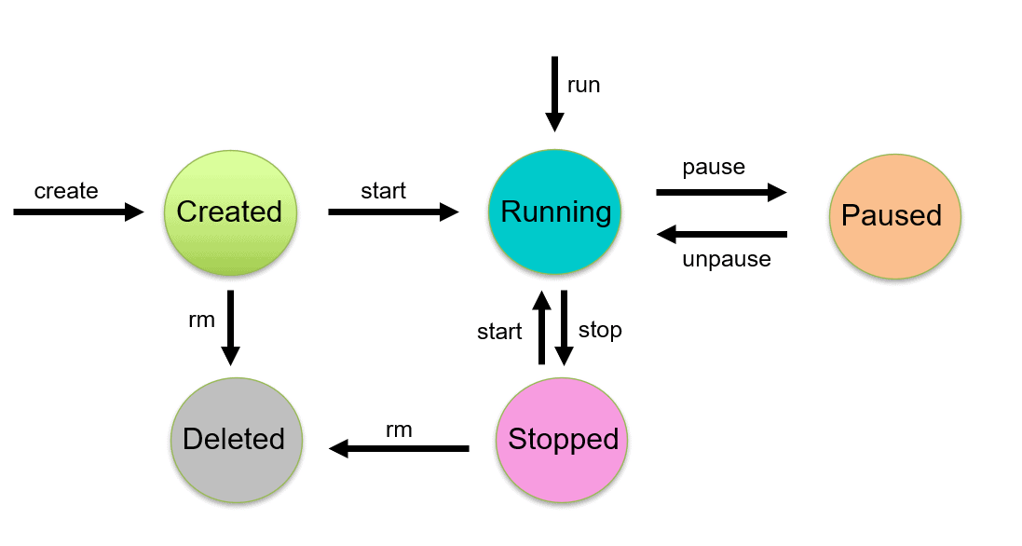
Docker Container Lifecycle Management Architecture.
Diagram

Slide 20
Docker Management Commands
Create Containers
  Using this will create a new Docker container with the specified Docker image
$ docker create --name <container name> <image name>
$ docker create --name c1 ubantu

Slide 21
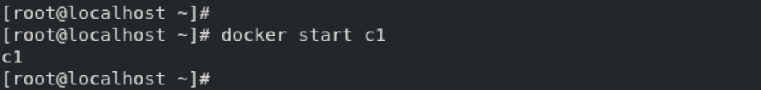
Docker Management Commands (Cont.)
Start Container
  To start a stopped container, we can use the docker start command.
docker start <container name>

Slide 22
Docker Management Commands (Cont.)
Run Container
  The docker run command will do the work of both “docker create” and “docker start” command.
  This command will create a new container and run the image in the newly created container.
$ docker run -it --name <container name> <image name>

Slide 23
Docker Management Commands (Cont.)
Pause Container
  If we want to pause the processes running inside the container, we can use the “docker pause” command.
$ docker pause <container name>

Slide 24
Docker Management Commands (Cont.)
Stop Container
  Stopping a running Container means to stop all the processes running in that Container. Stopping does not mean killing or ending the process.
$ docker stop <container name>

Slide 25
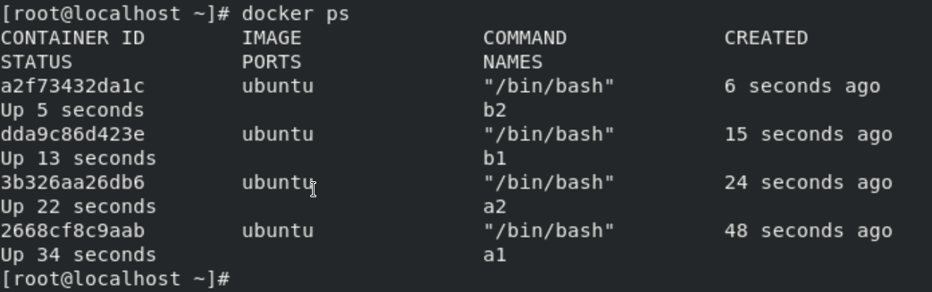
Docker Management Commands (Cont.)
Stop Container
  We can stop all the containers using a single command. In our case, 4 containers are running which you can see using the docker ps command.

Slide 26
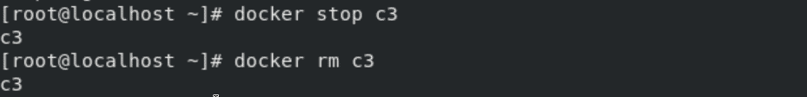
Docker Management Commands (Cont.)
Delete Container
  Removing or deleting the container means destroying all the processes running inside the container and then deleting the Container.
  It’s preferred to destroy the container, only if present in the stopped state instead of forcefully destroying the running container.
$ docker rm <container name>

Slide 27
Thanks
…?

